Slide 1
SOFTWARE ENGINEERING MINI PROJECT
TITLE : API RATE LIMITER
NAME : ANKITA MUNI (PES1UG23CS081)
MANASA S A (PES1UG24CS811)
ARYA S (PES1UG23CS107)
LIKITHA H ( PES1UG24CS810)
TEAM : QUAD CORE

Slide 2
Table of Contents
1
What is API rate limiter ?
6
Sprint 2
2
Purpose of API Rate Limiter
7
Burndown Chart
3
SRS and Product Backlog
8
Branching Strategy
4
Epics
9
Retrospective
5
Sprint 1
10
Test Plan Document

Slide 3
Table of Contents
11
Code Coverage and Pylint Score
16
Deployment Artifacts
12
CI/CD Pipeline
17
Project Links
13
Continuous Testing
14
Software Architecture Design
15
Front-End Design

Slide 4
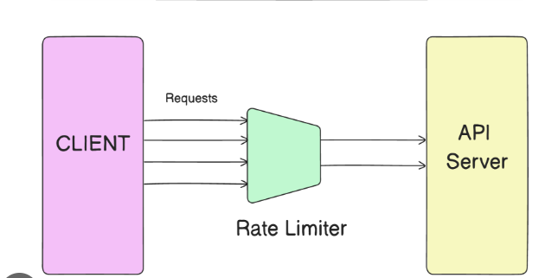
What is API Rate Limiter?
An API Rate Limiter is a control mechanism that restricts how many times a user, application, or system can make API requests within a specific time period (like per second, per minute, or per hour)

Slide 5
Purpose of API Rate Limiter
It’s mainly used to:
Prevent abuse — stop users or bots from overloading the server with too many requests.
Ensure fair usage — distribute resources evenly among all users.
Protect server stability — prevent crashes or slowdowns due to heavy traffic.
Control costs — limit API usage in paid or limited plans (e.g., free-tier users get fewer requests).

Slide 6
SRS document
https://github.com/pestechnology/PESU_RR_CSE_B_P73_API_Rate_Limiter_QuadCore/blob/main/docs/SRS/SRS.pdf
Product Backlog
https://ankitamuni2005-1755576805070.atlassian.net/jira/software/c/projects/QC/boards/34/backlog

Slide 7
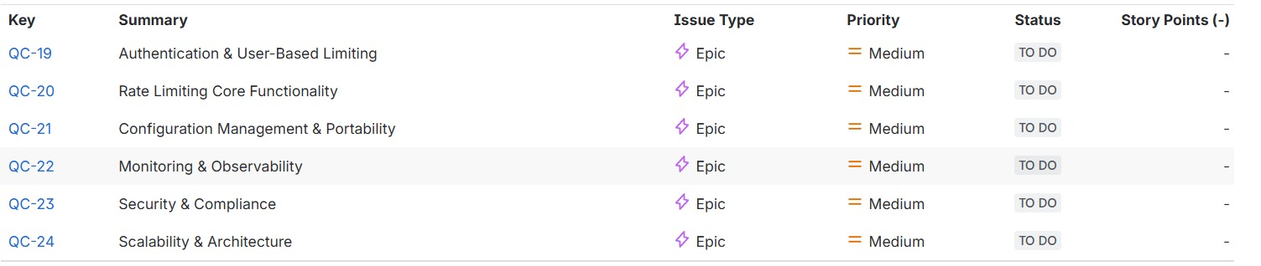
Epics

Slide 8
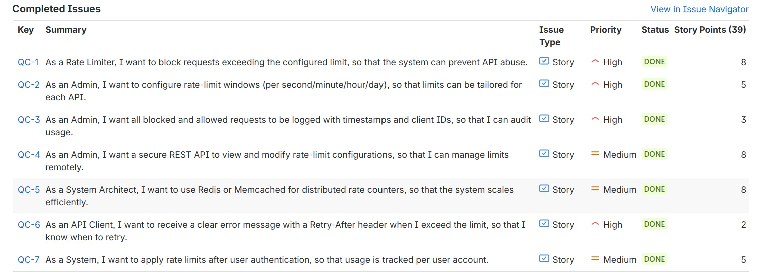
Sprint 1 - ( 8/10/25) to ( 24/10/25)

Slide 9
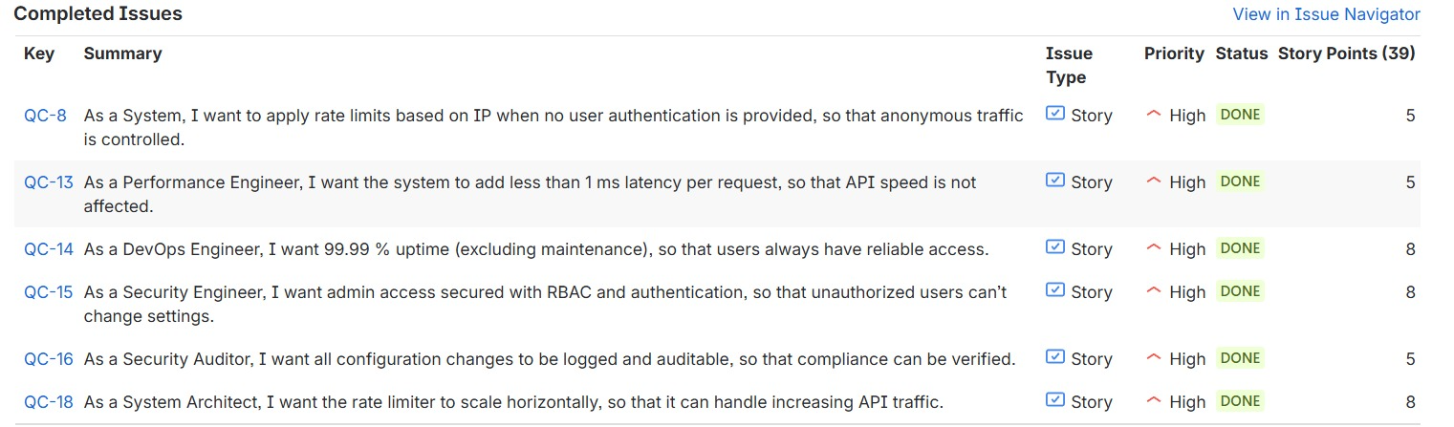
Sprint 2 - (24/10/25) to (11/11/25)

Slide 10
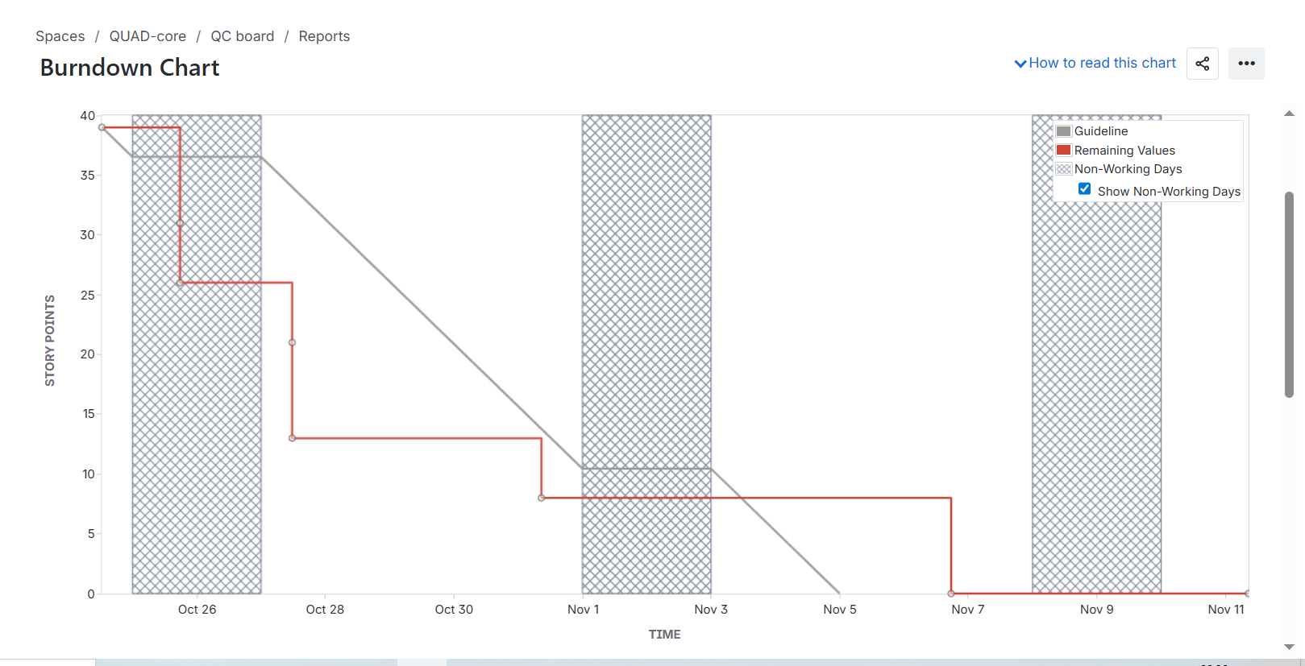
Burndown Chart

Slide 11
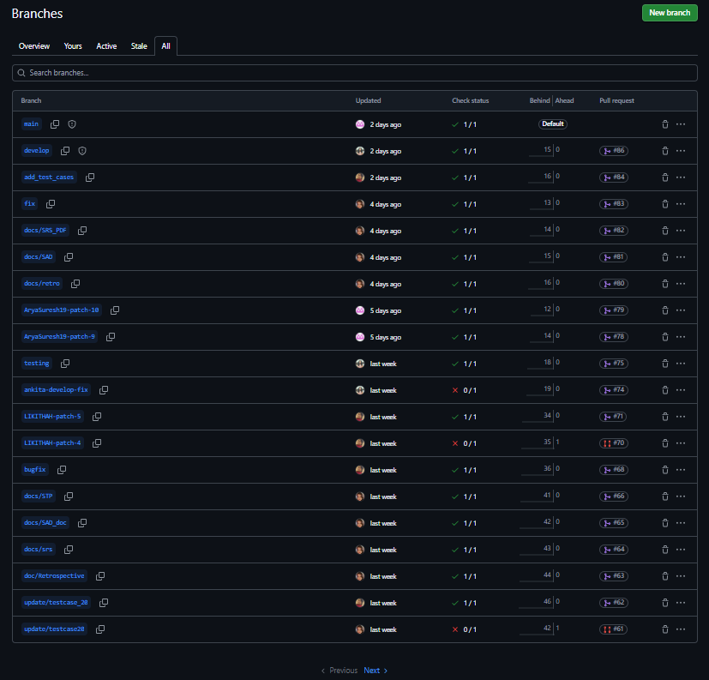
Branching Strategy

Slide 12
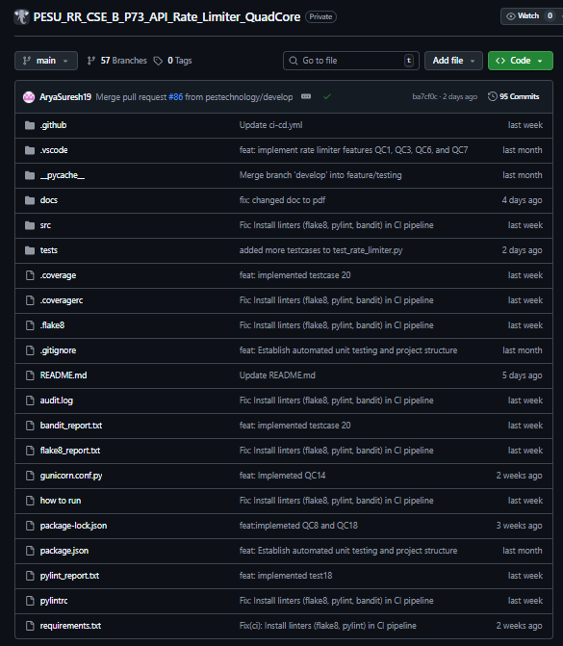
Commits and File Structure

Slide 13
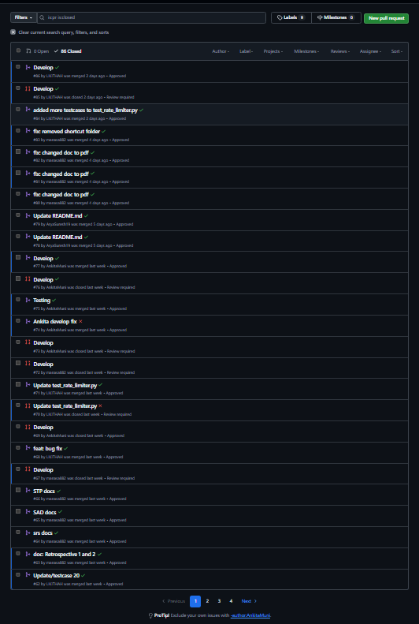
Pull Requests

Slide 14
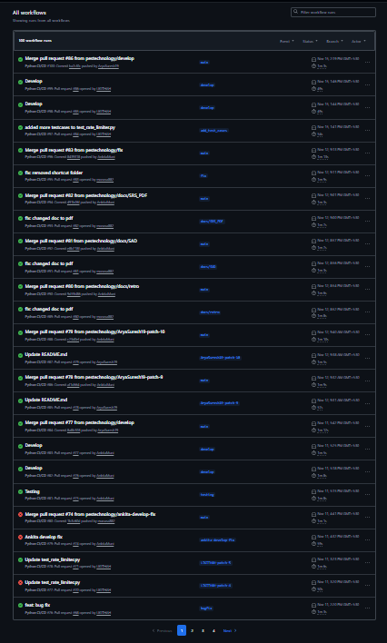
Workflows

Slide 15
Retrospective
https://github.com/pestechnology/PESU_RR_CSE_B_P73_API_Rate_Limiter_QuadCore/tree/main/docs/Retrospective

Slide 16
Test Plan Document
https://github.com/pestechnology/PESU_RR_CSE_B_P73_API_Rate_Limiter_QuadCore/blob/main/docs/STP/STP.pdf
System Testing | 29 test cases
Unit Testing | 18 test cases
Integration Testing | 3 test cases

Slide 17
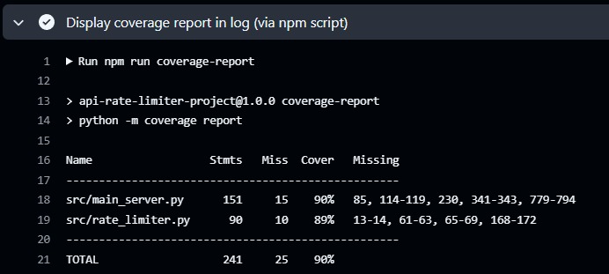
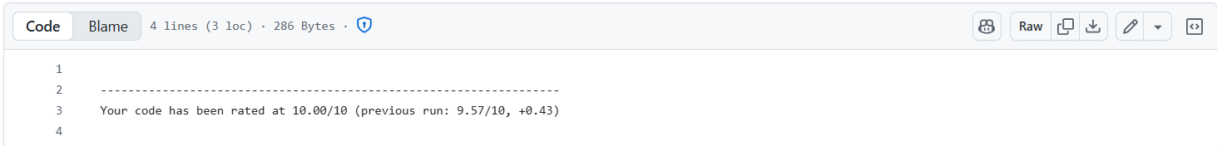
Code Coverage and Pylint Score

Slide 18
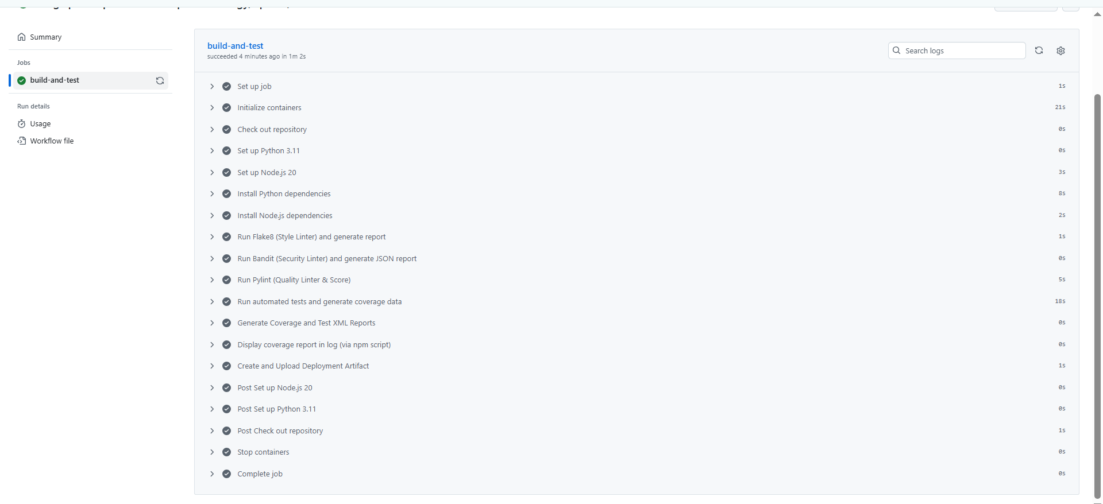
CI/CD Pipeline

Slide 19
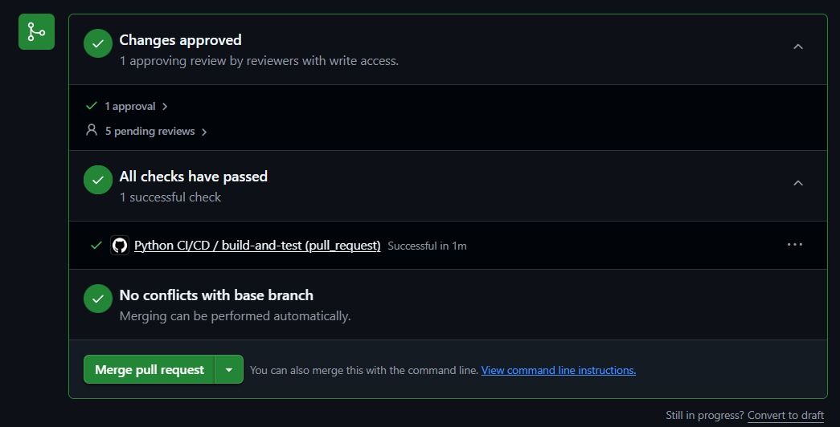
Continuous Testing

Slide 20
Software Architecture Design
https://github.com/pestechnology/PESU_RR_CSE_B_P73_API_Rate_Limiter_QuadCore/blob/main/docs/SAD/SAD.pdf

Slide 21
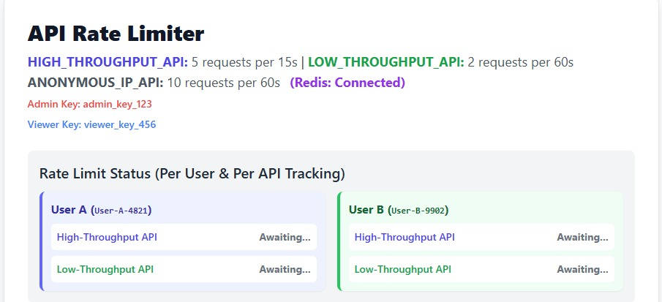
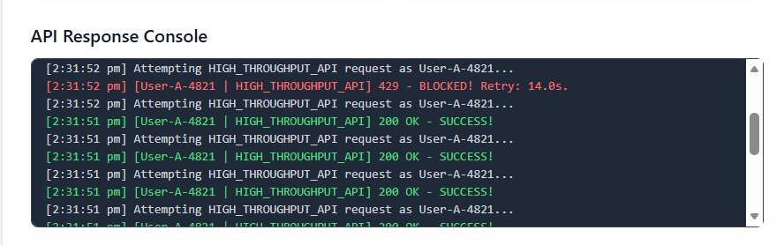
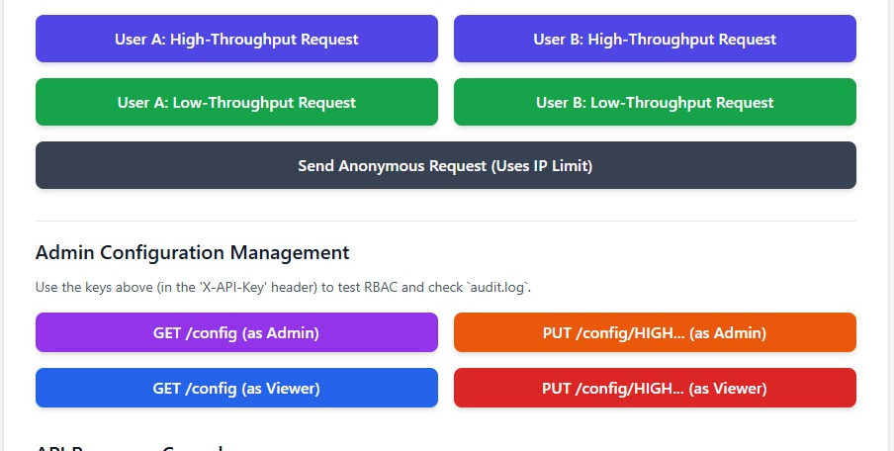
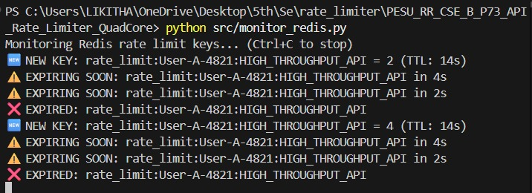
Frontend Design

Slide 22
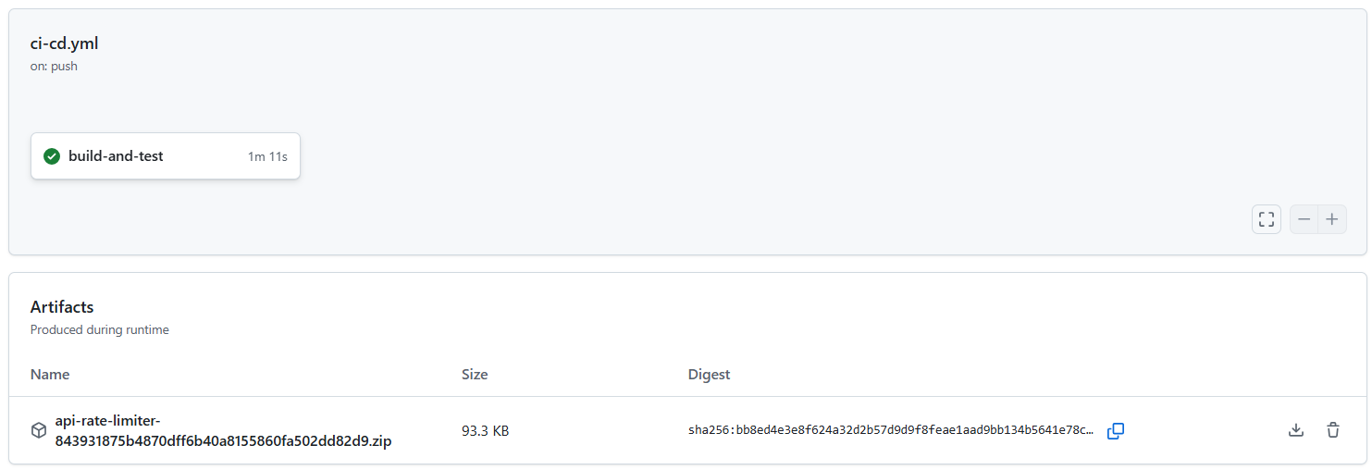
Deployment Artifacts

Slide 23
Project Links
GITHUB :
https://github.com/pestechnology/PESU_RR_CSE_B_P73_API_Rate_Limiter_QuadCore
JIRA :
https://ankitamuni2005-1755576805070.atlassian.net/jira/software/c/projects/QC/boards/34

Slide 24


